Slide 1
Maintain Your Brain: Tips and Lifestyle Habits to Sustain Cognitive Health
Lisa Nelson, MD,
lnelson@CHPBerkshires.org
WATCH THE VIDEO HERE

Slide 2
Lisa Nelson, MD
CHP Family Medicine Physician and Director of Provider Wellness
Past Clinical Instructor, Department of Family Medicine and Community Health, University of Massachusetts – Chan Medical School
Clinical Assistant Professor, Dept. of Family Medicine, University of New England, College of Osteopathic Medicine.
Dr. Nelson has worked with medical schools, community groups and allied health professionals throughout the U.S. to raise awareness of the treatment/prevention of chronic disease through lifestyle practices including yoga, exercise and nutrition.
She has presented her work at the U.S. Capitol and Library of Congress.
Co-author w/Annie B. Kay, of the book Yoga and Diabetes, published by the American Diabetes Association, Spring 2015.

Slide 3
The Burden of Dementia
About 5.8 million people in the United States have dementia (CDC)
Over 95% of those affected are 65 or older
By 2060, the number of Alzheimer’s cases is predicted to rise to 14 million
BUT! There is hope!

Slide 4
The Good News
Dementia and cognitive decline, like other chronic disease, can be prevented or delayed!
The recently published "Maintain Your Brain" study showed that intensive online coaching intervention and the control 'education only' group lowered the risk of dementia in participants who made and maintained lifestyle changes

Slide 5
The Maintain Your Brain (MYB) Study
Participants: Over 6,000 Australians, aged 55–77, with at least 2 of the dementia risk factors: poor nutrition, sedentary lifestyle, cognitive inactivity, and depression or anxiety.
One group received a schedule of personalized, online coaching targeting physical activity, nutrition, cognitive activity and depression or anxiety.
A control group received information only.
Cognition was assessed prior to study and after 3 years

Slide 6
The "Maintain Your Brain" Study
Cognition in both groups improved significantly over the 3-year period, with greater improvement in the coaching group.
Researchers noted significant improvements in aerobic activity, strength training, diet and depression.
Participants 55-65 showed greater benefit than those aged 66-77, suggesting that starting prevention programs earlier could be more effective.

Slide 7
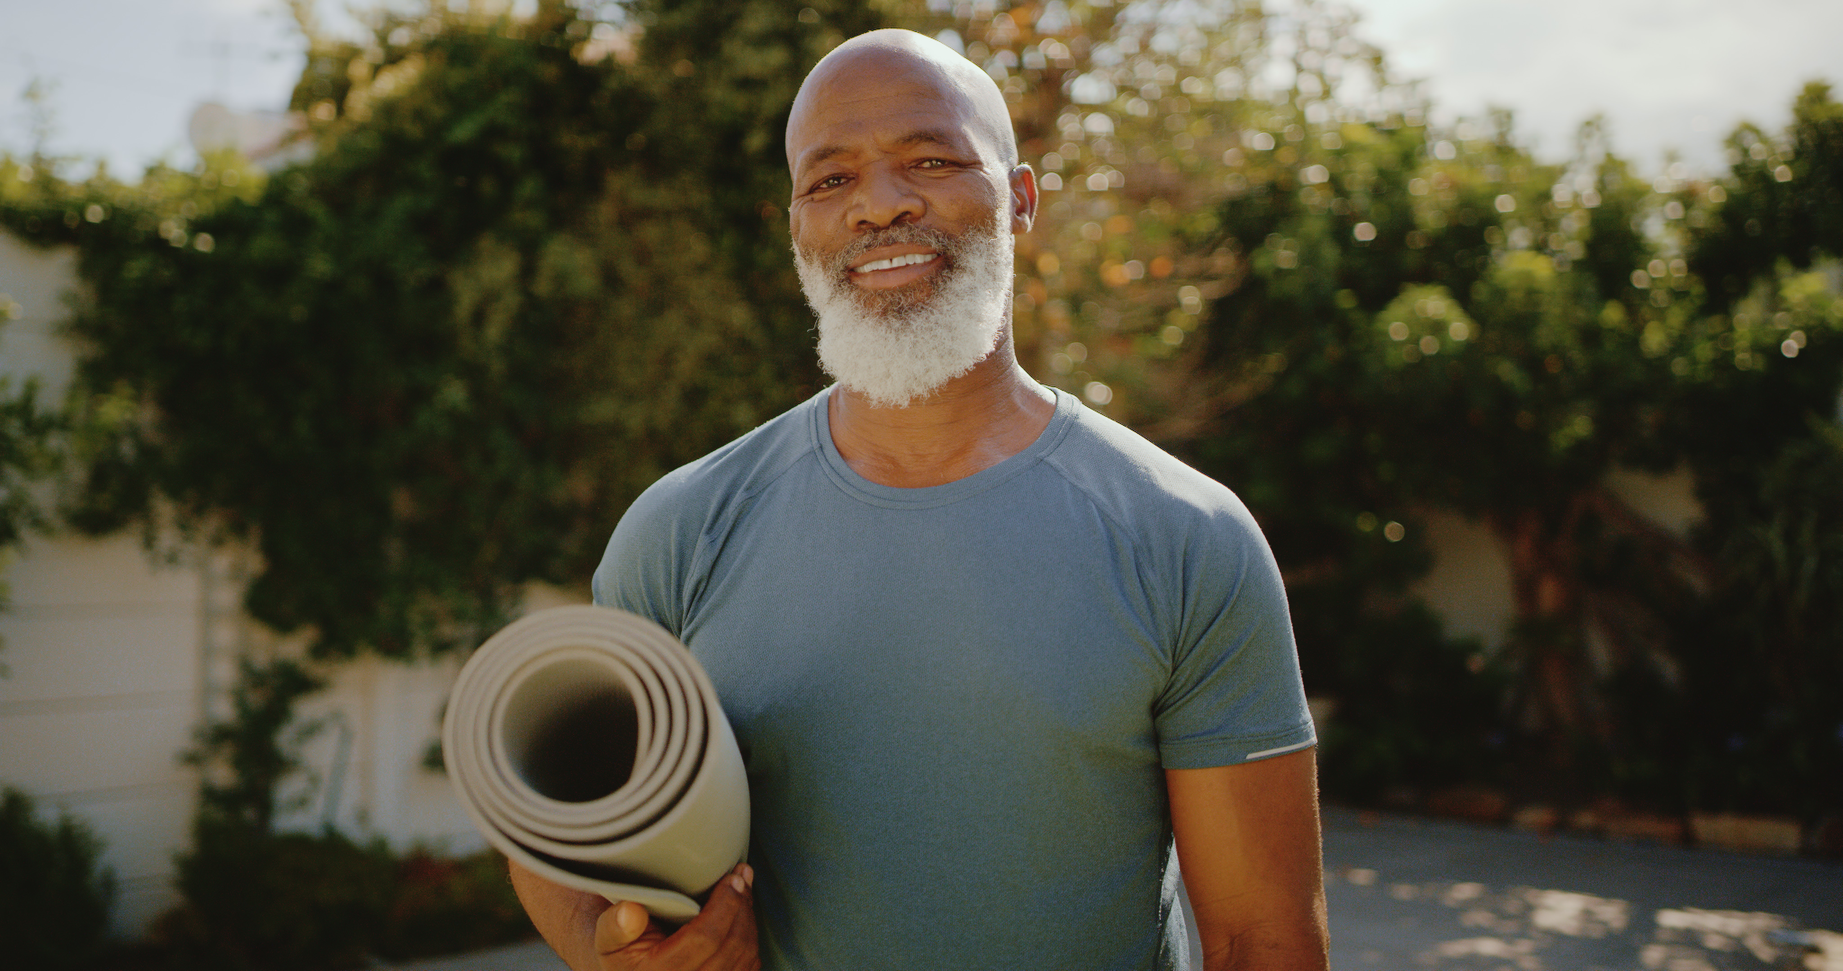
How to Maintain YOUR Brain
You can create your own intervention to improve your cognitive health. Let's focus on the same 4 domains as the MYB study:
Diet
Exercise
Emotional health
Brain training

Slide 9
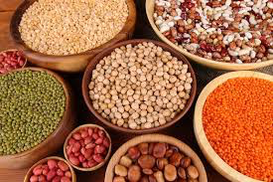
The Mediterranean Diet
One of the most well researched dietary patterns, this was the recommended diet in the MYB study
Shown to reduce the risk of high blood pressure, kidney disease, Type 2 diabetes, heart disease and dementia
Focuses on food quality, not food quantity
Vegetables, fruits, legumes, grains, nuts/seeds, extra virgin olive oil, moderate amounts of fish/shellfish, low intake of meat, dairy, eggs, refined sugars and animal fats

Slide 10
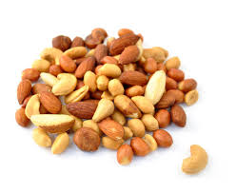
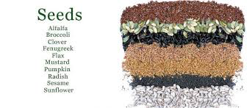
Foods to Support Brain Health

Slide 11
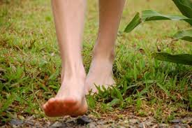
Movement is Medicine!

Slide 12
Movement is Medicine!
MYB study: 300 minutes of moderate movement each week, or or 150 minutes of vigorous movement.
Other studies have shown 150 minutes/week to be positively associated with bone, metabolic and cardiac health.
Weight bearing exercise, like walking, are key for bone health.
Agility and balance are also key: Qi Gong, yoga and physical therapy have all been shown to improve balance and prevent falls
The best exercise is always the one you enjoy and will do regularly!
Notes:
RESULTS:
From 1986 to 1998, 415 incident hip fracture cases were identified. After controlling for age, body mass index, use of postmenopausal hormones, smoking, and dietary intakes in proportional hazards models, risk of hip fracture was lowered by 6% (95% confidence interval [CI], 4%-9%; P<.001) for each increase of 3 metabolic equivalent (MET)-hours per week of activity (equivalent to 1 h/wk of walking at an average pace). Active women with at least 24 MET-h/wk had a 55% lower risk of hip fracture (relative risk [RR], 0.45; 95% CI, 0.32-0.63) compared with sedentary women with less than 3 MET-h/wk. Even women with a lower risk of hip fracture due to higher body weight experienced a further reduction in risk with higher levels of activity. Risk of hip fracture decreased linearly with increasing level of activity among women not taking postmenopausal hormones (P<.001), but not among women taking hormones (P =.24). Among women who did no other exercise, walking for at least 4 h/wk was associated with a 41% lower risk of hip fracture (RR, 0.59; 95% CI, 0.37-0.94) compared with less than 1 h/wk. More time spent standing was also independently associated with lower risks.

Slide 13
Forest bathing (shinrin-yoku)
= Non-exercise time in nature
Researchers in Japan, Korea, Scandinavia and the US have studied the effects of forest bathing and found it:
Lowers heart rate and blood pressure
Decreases in cortisol & other stress hormones
Reduces anxiety & depression
Improves attention & cognition

Slide 14
Emotional Health
2023 Swedish study: depression and chronic stress are independent risk factors for cognitive impairment.
That risk nearly doubled for people suffering from both depression and chronic stress.
MYB participants received training with a digital mental health program, based on principles of cognitive behavioral therapy, to reduce depression and anxiety.

Slide 15
Stress: Not Always a Bad thing!
Adaptive
Functional
Improves performance
Healthy in the right dose

Slide 16
Sympathetic Nervous System (SNS)
“Fight or flight” system
Responds to perceived threats
Prepares the body and mind for action
Beneficial in the short-term
Can lead to imbalance and/or disease states when chronically or inappropriately engaged

Slide 17
Chronic Stress
Causes exhaustion and emotional dysregulation
Promotes inflammation and hyperglycemia
Increases risk of chronic disease (high blood pressure, heart disease, diabetes, dementia)

Slide 18
What’s the Cure?
Engage the parasympathetic nervous system
“Rest and Digest”
Notes:
18

Slide 19
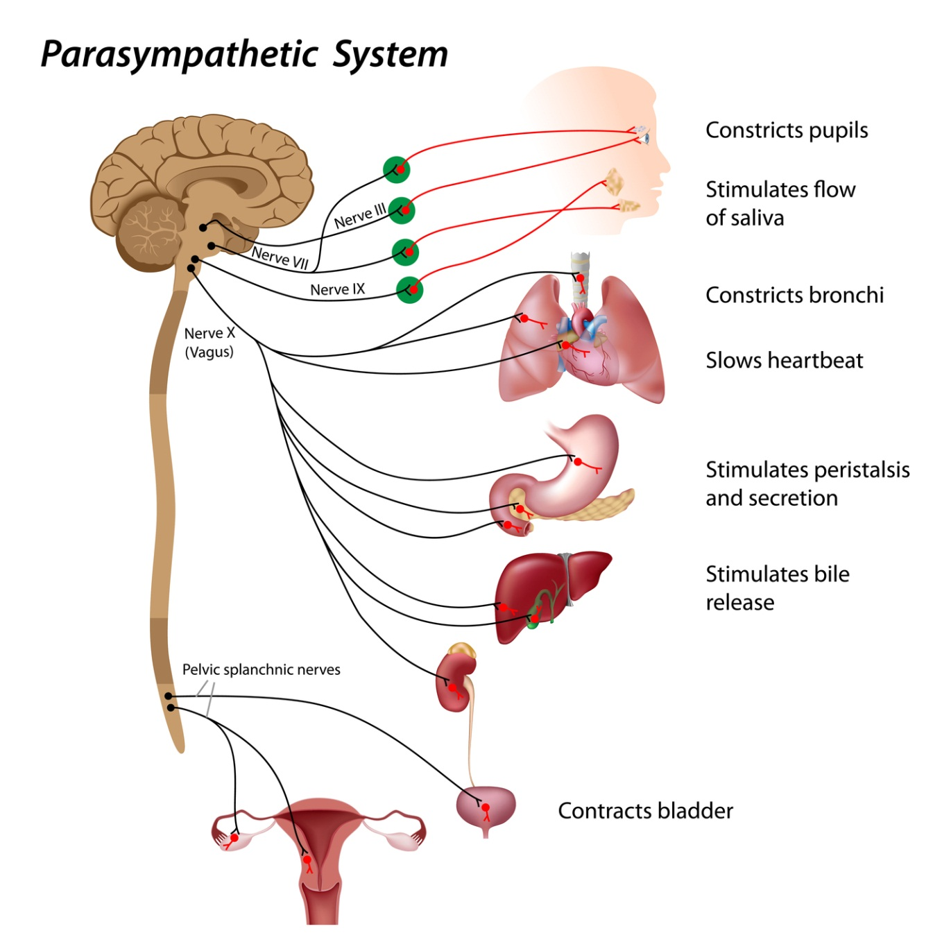
Parasympathetic Nervous System (PNS)
Decreases heart rate
Slows respirations
Increases blood flow to internal organs
Decreases muscular tension
Brings a feeling of calm
Allows maintenance/regulation of long-term internal processes

Slide 20
Yoga and Mindfulness for Emotional Health
Meditation and yoga have been shown to strengthen PNS, decrease stress, and improve emotional regulation.
Activation of the "rest and digest" system is achieved by practicing slow, steady breathing.

Slide 21
Exercise Your Brain!
The MYB study targeted seven cognitive functions: verbal executive, verbal memory, visual executive, visual memory, visual attention, speed and working memory
Allocated three 45-minute sessions each week over the first 10 weeks, and then monthly sessions
Some studies have shown that people who do mentally stimulating activities may have a lower risk of developing dementia, but there's limited evidence to show that computer-based brain training improves cognition over time
Data on physical exercise and overall physical health is much stronger

Slide 22
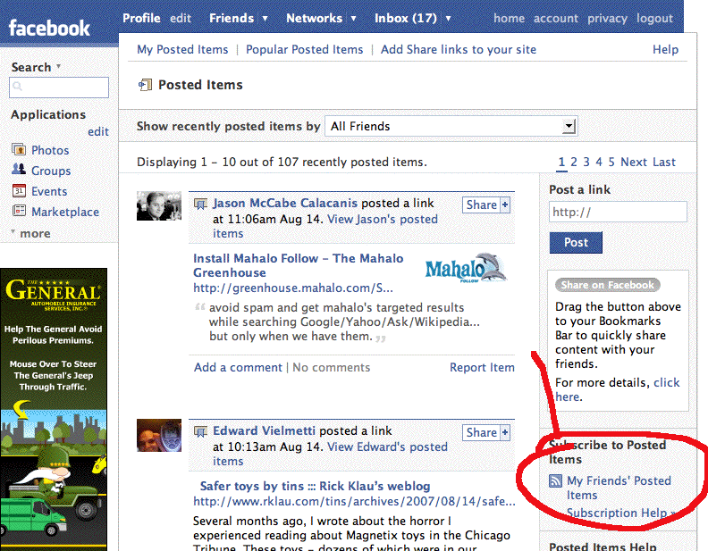
LIMIT THIS!
News Feed Eradicator—download this extension to your desktop/laptop computer's browser (Chrome, Firefox, Safari)

Slide 23
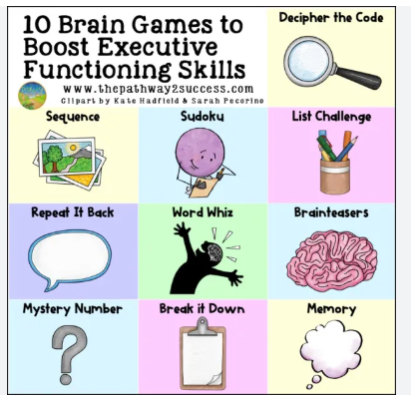
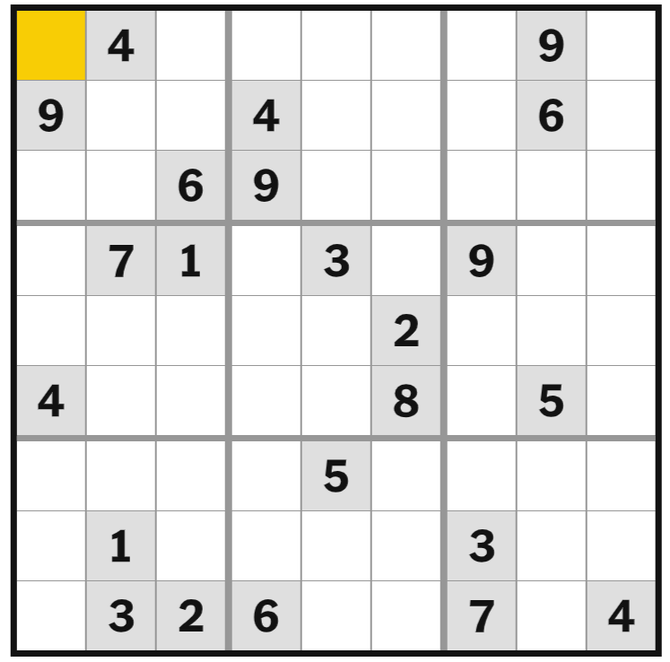
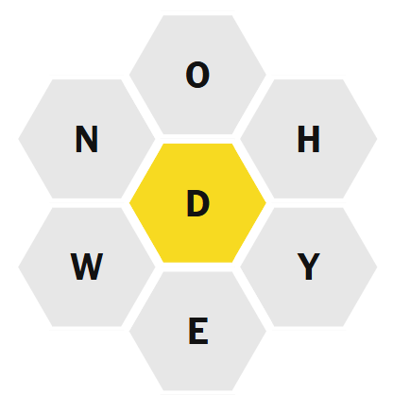
Could be Helpful (and Fun) to Add!

Slide 24
You Can Likely Improve Cognitive Health By...
Learn a new language
Learn a new instrument
Learn a new dance (or sport)
Engaging different senses across multiple types of learning preserves and/or creates new neural networks

Slide 25
Tips to Maintain Cognitive Health:
Whole food, plant rich diet with lots of beans, greens, nuts, seeds, seafood and olive oil
Move more! At least 30 min a day of moderate/vigorous exercise daily
Alcohol in moderation: <1 serving a day (or none at all!)
Cultivate an active support network
Take “breathing breaks” throughout the day to decrease stress
Learn new things!
Get a good night's rest

Slide 26
In Summary...
Nourishing foods
Nourishing friends
Nourishing play ☺

Slide 27
Resources!
​For CHP Patients...
Mindful Movement & Meditation:
Tuesday, 4:30-5:30, w/ Lisa Nelson, MD
Wednesdays, noon-1, w/Kim Loring, MS, PMHNP
Both groups include Mary Northey, Certified Yoga Therapist
chpberkshires.org/group-health
CHP Nutrition Services
Ashli Minor, Nutritionist
Aminor@chpberkshires.org

Slide 28
For Everyone...Fitness, Learning, Social Time!
Free or low-cost activities are right in your neighborhood, and online!
Community Centers
Libraries
Senior Centers (fitness, learning, social time, community meals)
Yoga and Meditation Classes, in person or online
Walking & Hiking with Friends
Brain Games
Book Groups, Volunteering, Language & Music Learning

Slide 29
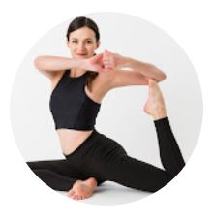
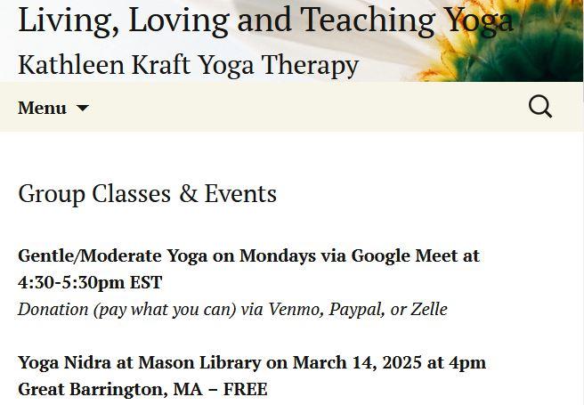
Online Activities

Slide 30
Many thanks!!

